Slide 1
Uniform Circular Motion

Slide 2
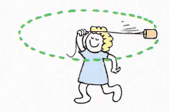
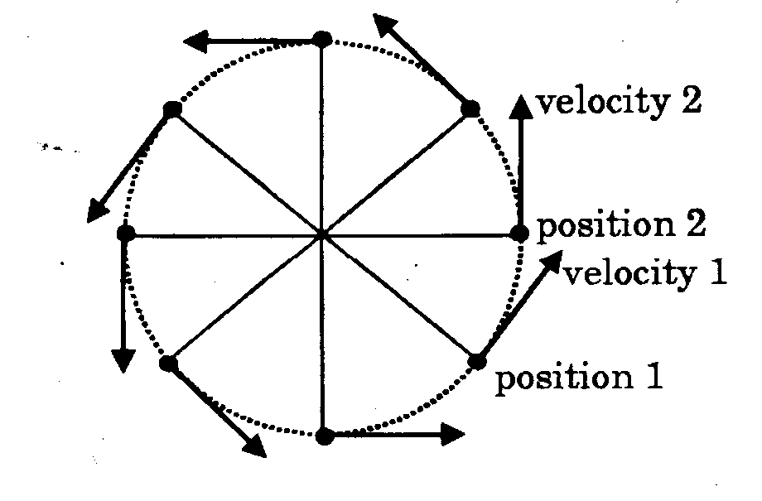
2.1 Objects moving in circles
Newton's First Law says that ‘any object remains at rest or moving with constant speed in a straight line unless acted on by a force.’
Since the stone is neither at rest nor moving in a straight line, a force must be acting on it.
Forces produce acceleration as stated by Newton's Second Law. Why is a stone whirled around on the end of a string accelerating?
At each point the stone has an instantaneous linear, or tangential, velocity in a particular direction. An instant later, as the position of the stone changes its velocity also changes direction.
Remember, velocity is a vector quantity and therefore as soon as the direction changes it becomes a new velocity, even though the speed of the stone has not changed.
Acceleration occurs when velocity changes, therefore any object moving in a circle is accelerating. This acceleration is called centripetal acceleration.

Slide 3
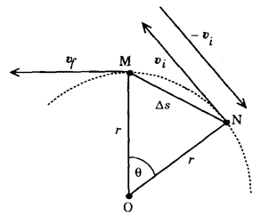
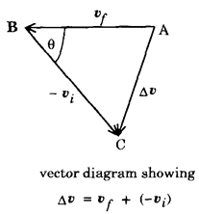
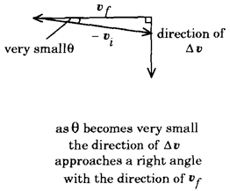
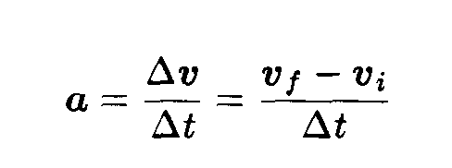
2.2 Centripetal acceleration
Centripetal means centre seeking, which suggests that the acceleration of an object moving in a circle is directed towards the centre.
Centripetal acceleration is always directed towards the centre of the circle.

Slide 4
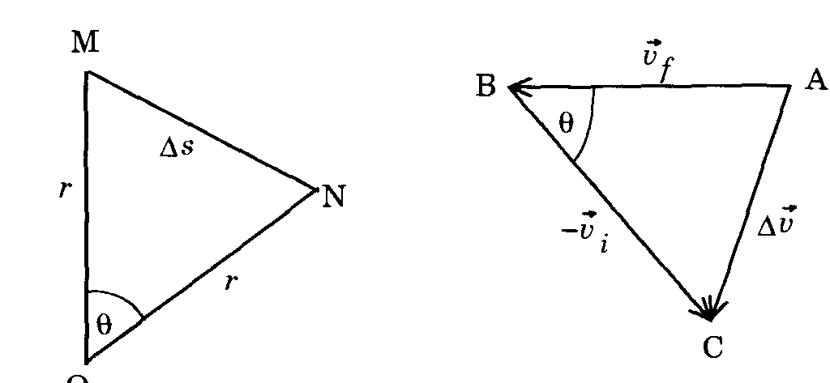
2.2.2 Size of the centripetal acceleration
Triangles ABC and MNO in Figure 2.3 are similar triangles
Derivation of this equation is not required for the examination.

Slide 5
2.3 Relationship between period and linear velocity
The period, T, of an object moving in a circle is the time it takes to make one revolution or travel around the circle once.
For one revolution, the distance travelled is the circumference of the circle, which is 2πr, and the time is the period, T.
Since v is given by

Slide 6
Example 2.1
A student finds that the time for 10 revolutions of a stone, being whirled around on a string 0.50 m long, is exactly 8.0 seconds.
(a) what is the period of the stone?
(b) what is the linear speed of the stone?
(c) what is its centripetal acceleration?

Slide 7
Answer
Time for 10 revolutions = 8.0 s r = 0.50 m
(a) Find the period
Period is the time for one revolution
$T= \frac{8}{10}$
= 0.80 s (2sf)
i.e. the period of the stone is 0.80 s
(b) Find the linear speed using the period
$$v= \frac{2πr}{T}$$
$$= \frac{2 × π ×0.5}{0.8}$$
$$=3.927$$
$=$3.9 ms⁻¹ (2sf)
i.e. the linear velocity of the stone is 3.9 ms^{‑1} at a tangent to the circle.

Slide 8
c)Find the centripetal acceleration
$$a_{c}= \frac{v^{2}}{r}$$
$$= \frac{{(3.927)}^{2}}{0.5}$$
= 30.84
= 31 ms⁻² (2sf)
i.e. the centripetal acceleration of the stone is 31 ms⁻² towards the centre.

Slide 9
Forces producing centripetal acceleration
Any net force, which is acting at right angles to the velocity of an object, will produce centripetal acceleration and therefore cause the object to follow a circular path.
The force producing centripetal acceleration is often called centripetal force.
Like centripetal acceleration, centripetal force always acts towards the centre of the circle.

Slide 10
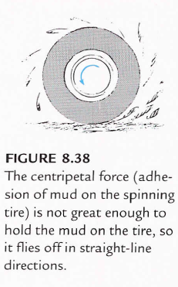
From Newton's Second Law:
$F=ma$
and since $a_{c}= \frac{v^{2}}{r}$
$${∴ F}_{c}= \frac{mv^{2}}{r}$$
Where F_{c} is the force producing centripetal acceleration

Slide 11
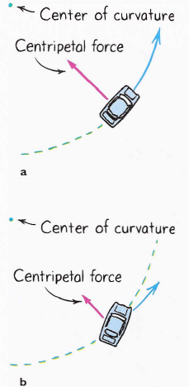
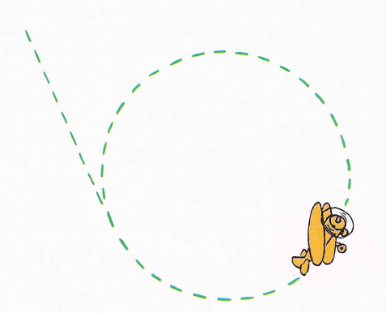
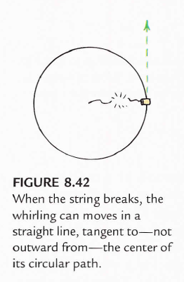

Slide 12
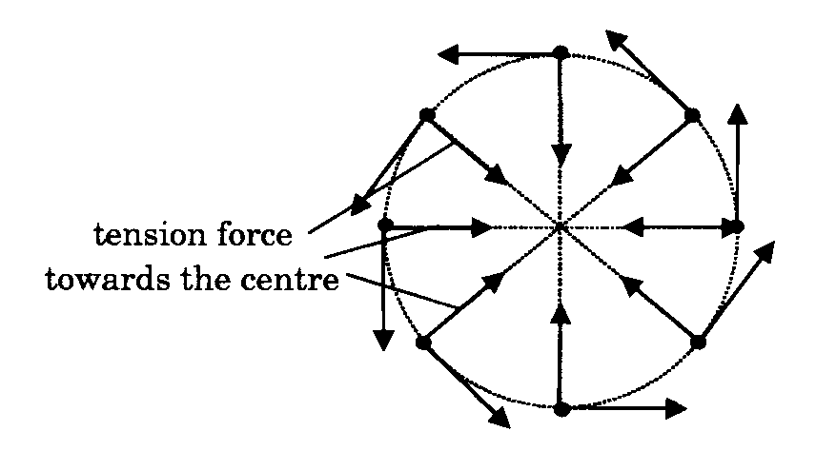
Tensile force
In the case of the stone whirled around on the string, the force which is continually pulling the stone towards the centre is the tension in the string.
If the string broke suddenly, the stone would fly off in the direction of its velocity at that instant, i.e. Its linear, or tangential, velocity.

Slide 13
2.4.2 Gravitational force
The moon and artificial satellites travel around the earth and the planets travel around the sun because the force of gravity acts as a force producing centripetal acceleration

Slide 14
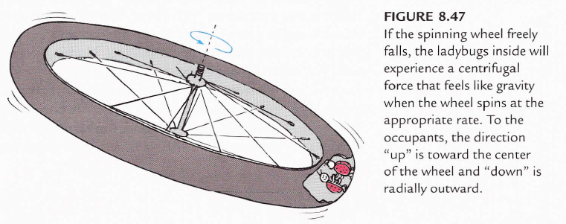
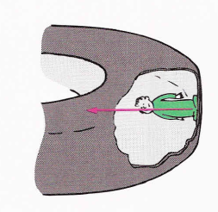

Slide 15
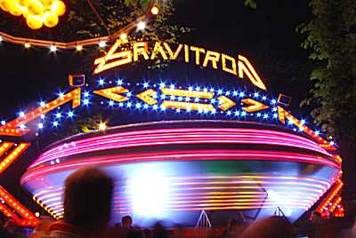
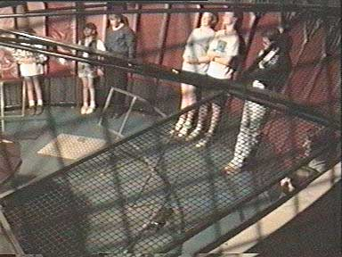
Real world examples of Centripetal Force

Slide 17
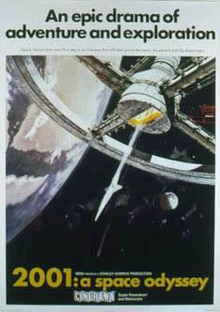
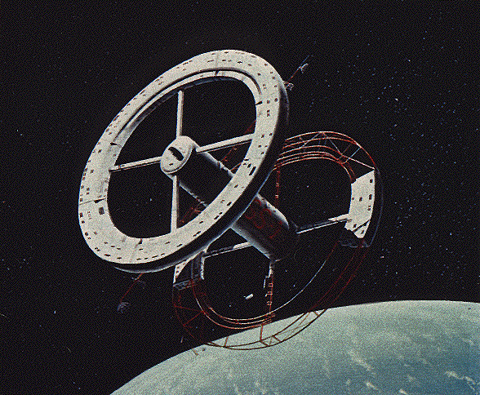

Slide 18
Future space station???

Slide 19
2.4.3 Frictional force
A car is able to move on a road because of the friction force between its tyres and the road surface.
If there was no friction, the tyres would simply slip on the surface and the car would not be able to move.

Slide 20
Forces on a car
A car on a road has a number of forces acting on it:
the force of the engine pushing forwards
friction pushing back
the car's weight pushing down
a normal force pushing up, as required by Newton's Third Law.

Slide 21
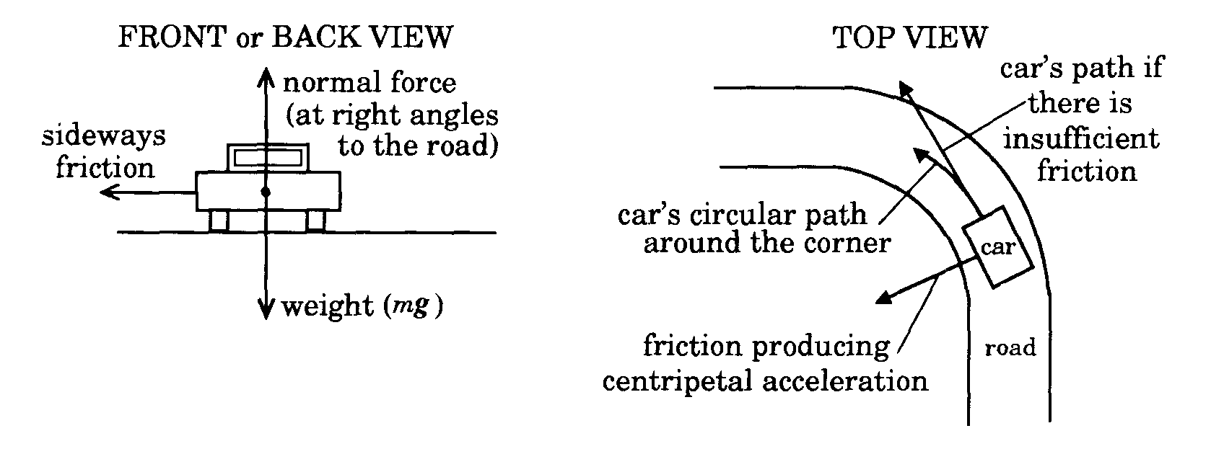
Normal force
The normal force is always at right angles to the road surface and is only equal and opposite to the car's weight when it is on a flat road.
When the car is travelling with constant speed in a straight line all these forces are balanced and the net force is zero.

Slide 22
sideways friction
When the car is turning the corner it is travelling around part of a circle, and therefore there must be a force acting on the car to produce centripetal acceleration.
This force is the sideways friction between the car's tyres and the road.
This is not a balanced force and changes the car's direction.

Slide 23
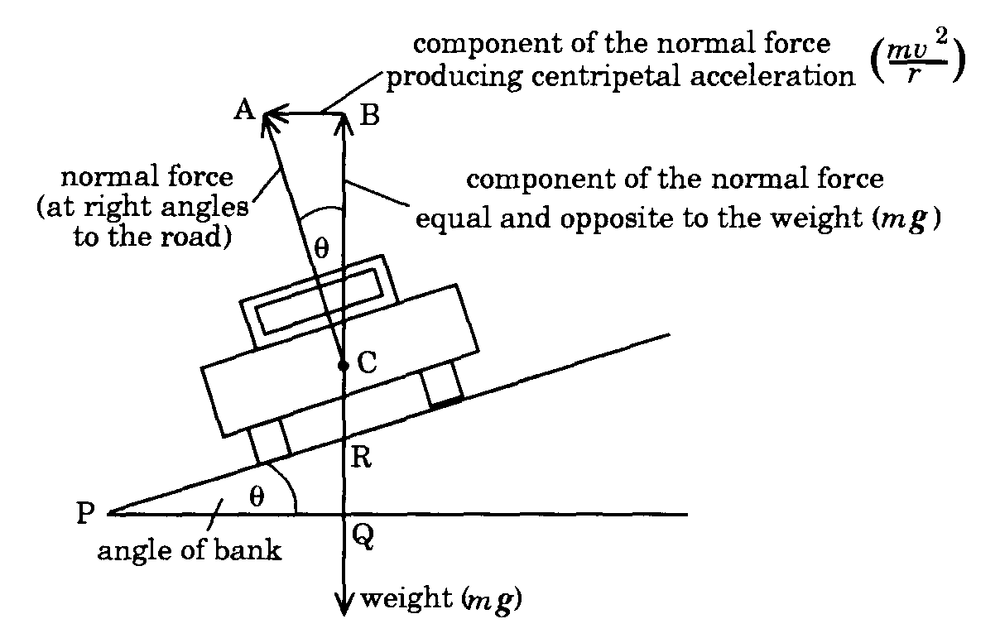
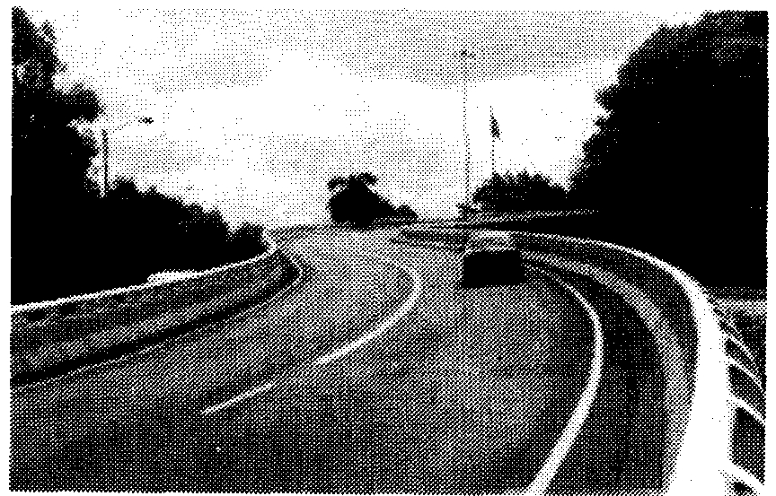
2.4.4 Normal force on banked roads
In many situations a curving road can be made safer by building it at an angle.
The road is said to be banked and in this situation the normal force to the road surface provides additional centripetal acceleration

Slide 25
Banked roads
As the diagram shows, the normal force can be resolved into two components, one vertical, and the other horizontal.
The vertical component is equal but opposite to the weight of the car.
The horizontal component produces a force at right angles to the car's direction of motion, towards the centre of the circle made by the road.
This component of the normal force is the force producing the centripetal acceleration.

Slide 26
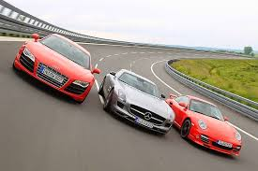
Banked Roads
For a given banking angle, there is a certain speed whereby the centripetal acceleration is entirely produced from the normal force.
This means no friction is required from the tyres to keep the car from sliding

Slide 27
Derivation of banking equation
From the geometry of the triangles ABC and PQR in Figure 2.7, the two angles marked θ are equal
and weight = mg
So from triangle ABC
and cancelling m on the top & bottom gives

Slide 28
Example 2.2
A road has speed limit of 70 km per hour.
What banking angle is required for a curve of radius 400 m, which will allow vehicles to travel around the curve at 70 km per hour without relying on friction?
What centripetal acceleration will a car experience travelling at this speed around the curve?
v = 70 kph = 19.44 ms⁻¹ r = 400 m
(a) Find the banking angle using:
Find the centripetal acceleration using:
i.e. the banking angle required is 5.5°.
i.e. the car's centripetal acceleration is 0.94 ms^{‑ 2} towards the centre of the circle.

