Slide 1
The Structure of the Nucleus

Slide 2
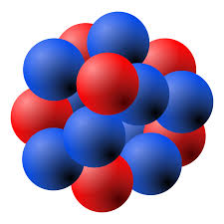
Composition of nuclei
Protons and neutrons
Protons are positively charged
Neutrons are neutral
Nucleon – either a proton or a neutron.

Slide 3
Nuclear notation
${}_{Z}^{A}X$
Mass number, A – number of nucleons in the nucleus of an atom.
Atomic number, Z – number of protons in the nucleus of an atom.

Slide 4
The force between nucleons
Protons repel due to the electrostatic force.
What then stops the nucleus from exploding?
The nuclear force is an attractive force that acts between nucleons.
Also called the strong nuclear force, this force acts over a short range.
Neutrons in the nucleus act to shield the protons from each other and strengthen the attractive force.

Slide 5
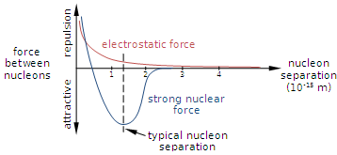
Graph of nucleon force vs distance

Slide 6
Isotopes
The number of protons determines the element.
But, nuclei of a given element may have different numbers of neutrons.
Isotopes have different mass numbers.
For example, ${}_{}^{\text{12}}{\text{C}}, {}_{}^{\text{13}}{\text{C}},{}_{}^{\text{14}}{\text{C}}$or carbon-12, carbon-13, carbon-14

Slide 7
ISOtope Chemistry
Have the same outer electronic structure
Hence they are chemically identical.

Slide 8
Phet simulation
Download at: http://tinyurl.com/mbtpcmt
Have a play
For each element find:
The most abundant isotope
Least abundant, stable isotope

Slide 9
Mass defect
Example: The mass of a helium nucleus (also called an alpha particle) is $\sim 6.644657×{10}^{−27}$ kg.
If we add up the mass of 2 protons and 2 neutrons:
$2×1.67262178×{10}^{−27}+2×1.674927471×{10}^{−27}=6.695099×{10}^{−27}$
The mass of the alpha particle is less than the sum of all the masses of the constituent particles!

Slide 10
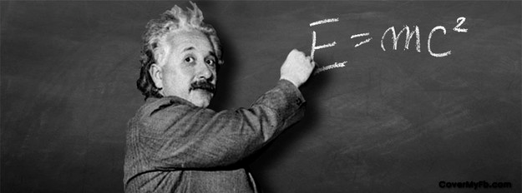
Mass defect
Interpret using:
$$E=mc^{2}$$
Where m is the mass and c is the speed of light in vacuum.
The missing mass is converted to energy and released.
Often in the form of a photon

Slide 11
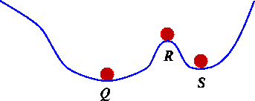
Minimum energy
A stable nucleus needs to have a lower energy than the separate particles.
For example, a ball on a hill:

Slide 12
Binding energy
To reverse the process and free the nucleons, we have to put that energy back in
We call this energy the binding energy:
$E_{b} \text{ =}∆mc^{2}$
Mass defect –difference between mass of nucleus and constituent particles.
Binding energy – energy required to remove particles from nucleus.

Slide 13
Binding energy
The binding energy of the alpha particle is then,
$$E_{b} =∆mc^{2} \\ =\left(6.695099−6.644657\right)×{10}^{−27}{\left(3×{10}^{8}\right)}^{2} \\ ={4.5398×10}^{−12} J \\ =28.3 MeV$$
Much higher than ionisation energies!
Because the nuclear force is much stronger than the electrostatic force.

Slide 14
Conservation laws in nuclear reactions
Unlike in chemical reactions, in nuclear reactions the products of the reaction can be different elements to the reactants. For example,
${}_{2}^{4}{He}+{}_{7}^{14}N→ {}_{8}^{17}O+{}_{1}^{1}H.$
Mass is not conserved.
Nuclear equations have other rules

Slide 15
Conservation of charge
Charge is conserved.
Hence the atomic number remains the same before and after the reaction.
We represent electrons in nuclear equations as: ${}_{−1}^{0}e$.
$${}_{2}^{4}{He}+{}_{7}^{14}N→ {}_{8}^{17}O+{}_{1}^{1}H.$$

Slide 16
Conservation of nucleon number
The total number of nucleons remain constant in a reaction, although the type of nucleon may change.
Hence the mass number remains the same.
$${}_{2}^{4}{He}+{}_{7}^{14}N→ {}_{8}^{17}O+{}_{1}^{1}H.$$

Slide 17
Conservation of mass – energy
The total energy remains the same.
The total mass of the product will be different.
Determine whether energy is absorbed or released by calculating the change in mass.
Increase in mass implies energy is absorbed.
Decrease in mass implies energy is released.

Slide 18
Conservation of momentum
$${\text{P}}_{\text{final}}\text{=}{\text{P}}_{\text{initial}}.$$
We can use this law to predict the directions and velocities of the reaction products.
For example: consider the decay of a Uranium-238 atom at rest:
$${}_{92}^{238}U→{}_{2}^{4}{He}+{}_{90}^{234}{Th}$$
Since the uranium was at rest,
$${\text{P}}_{\text{final}}\text{=}{\text{P}}_{\text{initial}}=0.$$
Hence the particles must move in the opposite directions, because there are only two of them and momentum is conserved:
$${\text{p}}_{He}+ {\text{p}}_{Th}=0.$$

Slide 19
Conservation of momentum
Hence,
$${\text{p}}_{He}=− {\text{p}}_{Th} \\ m_{He}{ v}_{He}={−m}_{Th}{ v}_{Th}$$
Since, the helium weighs much less, it must have a much higher speed than the thorium:
$$\frac{v_{He}}{{ v}_{Th}}=\frac{m_{Th}}{m_{He}}≈\frac{234}{4}=58.5.$$

Slide 20
Conservation of momentum
Similarly, we can calculate the ratio of the kinetic energies:
$$\frac{{KE}_{He}}{{KE}_{Th}}=\frac{1/2m_{He}v_{He}^{2}}{1/2m_{Th}{ v}_{Th}^{2}}=\frac{v_{Th}v_{He}^{2}}{v_{He}{ v}_{Th}^{2}}=\frac{v_{He}}{{ v}_{Th}}≈58.5$$
Therefore the helium has the greater kinetic energy.

Slide 21
Application: the production of medical radioisotopes
Radioisotopes - the isotopes of an element that are radioactive.
Such nuclei are unstable and will emit particles and electromagnetic radiation.
Two main uses of medical radioisotopes:
Diagnostic tool in imaging, for example in PET scans
Therapeutic techniques, where radiation is used to damage certain cells

Slide 22
Application: the production of medical radioisotopes
There are a few techniques for producing radioisotopes.
A nuclei can gain protons or neutrons or both.
Addition of neutrons produces isotopes of the same element.
Addition of protons will change the type of element.

Slide 23
Adding neutrons to nuclei
Neutrons fired at low kinetic energy may be captured by the nuclei.
But, neutrons moving too fast may be deflected, pass through or shatter the nucleus.
Example: production of a radioactive isotope of phosphorus, phosphorus-32:
$${}_{0}^{1}n+{}_{16}^{32}S→{}_{15}^{32}P+{}_{1}^{1}H$$

Slide 24
Adding protons to nuclei
Protons require high kinetic energy to approach the nucleus and not be repelled.
In the sun the high temperatures provide the protons with enough speed to overcome the repulsion.
We can accelerate protons by using a particle accelerator such as a cyclotron.
Example: production of a medical radioisotope, fluorine-18, commonly used in PET scans:
$${}_{1}^{1}H+{}_{8}^{18}O→{}_{9}^{18}F+{}_{0}^{1}n$$

Slide 25
Collision with other nuclei
We can also fire smaller, charged nuclei to produce radioisotopes.
Similar to adding protons.
For example, the medical radioisotope oxygen-15 is produced by colliding the hydrogen-2 isotope with nitrogen:
$${}_{1}^{2}H+{}_{7}^{14}N→{}_{8}^{15}O+{}_{0}^{1}n$$

Slide 26
Energy requirements
As radioisotopes are not stable, the mass defect of the reaction is often negative, indicating that energy must be absorbed.
This energy can be supplied by the kinetic energy of the collision particle.
The kinetic energy of the collision particle must be greater than the binding energy in order for conservation of momentum to hold.
If the kinetic energy is equal to the binding energy, then the products would have no momentum.

