Slide 1
Radioactivity

Slide 2

Radioactivity: Expect the Unexpected

Slide 3
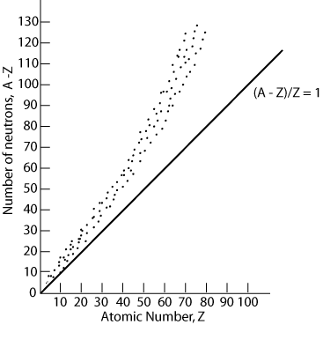
Stable and unstable nuclei
Not all nuclei are stable!
Consider the interaction between electrostatic force and strong nuclear force.
Nuclear Force | Electrostatic Force
Between nucleons | Between charged particles (e.g. protons)
Attractive | Repulsive for like charges
Short range | Long range, follows inverse square law

Slide 4
Features of stable nuclei
No stable nuclei exist past Z=83.
Stable lower mass nuclei have approximately equal numbers of protons and neutrons
Stable larger mass nuclei have more neutrons than protons
No stable nuclei with more protons than neutrons

Slide 5
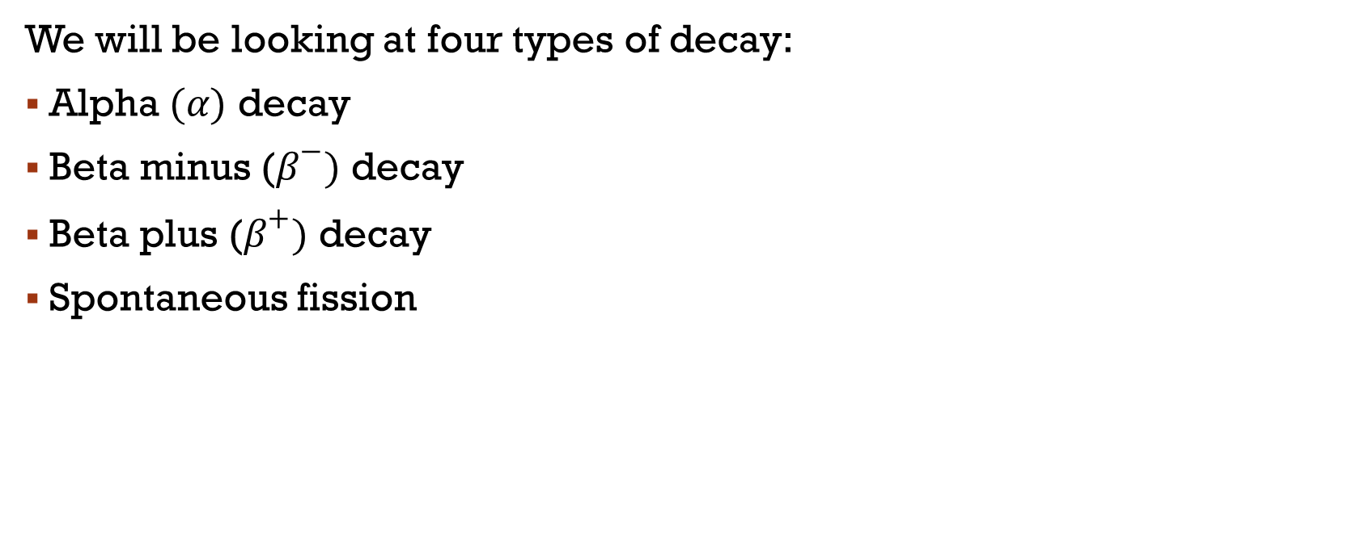
Types of decay of unstable nuclei
We will be looking at four types of decay:
Alpha $(α)$ decay
Beta minus ($β^{−})$ decay
Beta plus ($β^{+})$ decay
Spontaneous fission

Slide 6
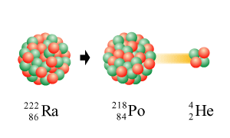

Alpha Decay
Alpha decay is one mechanism by which heavy unstable nuclei emit radiation and release energy.
After alpha decay the nucleus may or may not be stable.
An alpha particle consists of 2 protons and 2 neutrons...
i.e. a Helium nucleus
${}_{Z}^{A}X→{}_{Z−2}^{A−4}Y+α$

Slide 7
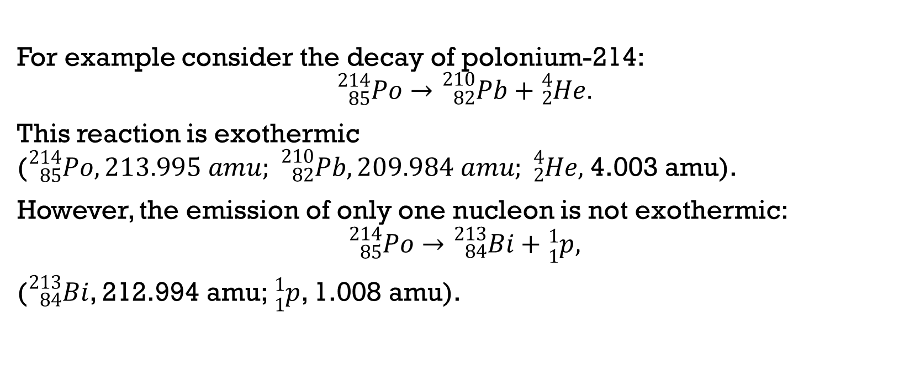
EXAMPLE: alpha decay
For example consider the decay of polonium-214:
$${}_{85}^{214}{Po}→{}_{82}^{210}{Pb+}{}_{2}^{4}{He}.$$
This reaction is exothermic (${}_{85}^{214}{Po}, 213.995 amu; {}_{82}^{210}{Pb}, 209.984 amu; {}_{2}^{4}{He},$4.003 amu).
However, the emission of only one nucleon is not exothermic:
$${}_{85}^{214}{Po}→{}_{84}^{213}{Bi+}{}_{1}^{1}p,$$
(${}_{84}^{213}{Bi}$, 212.994 amu; ${}_{1}^{1}p$, 1.008 amu).

Slide 8
Alpha particle energy
The excess energy of the reaction is released in the form of kinetic energy (mainly with the alpha particle) and as gamma radiation.
An interesting property of alpha decay is that the alpha particles are emitted with different energies, depending on the nucleus.
In fact, this is evidence that the nuclei have discrete energy levels, analogous to electron shells.

Slide 9
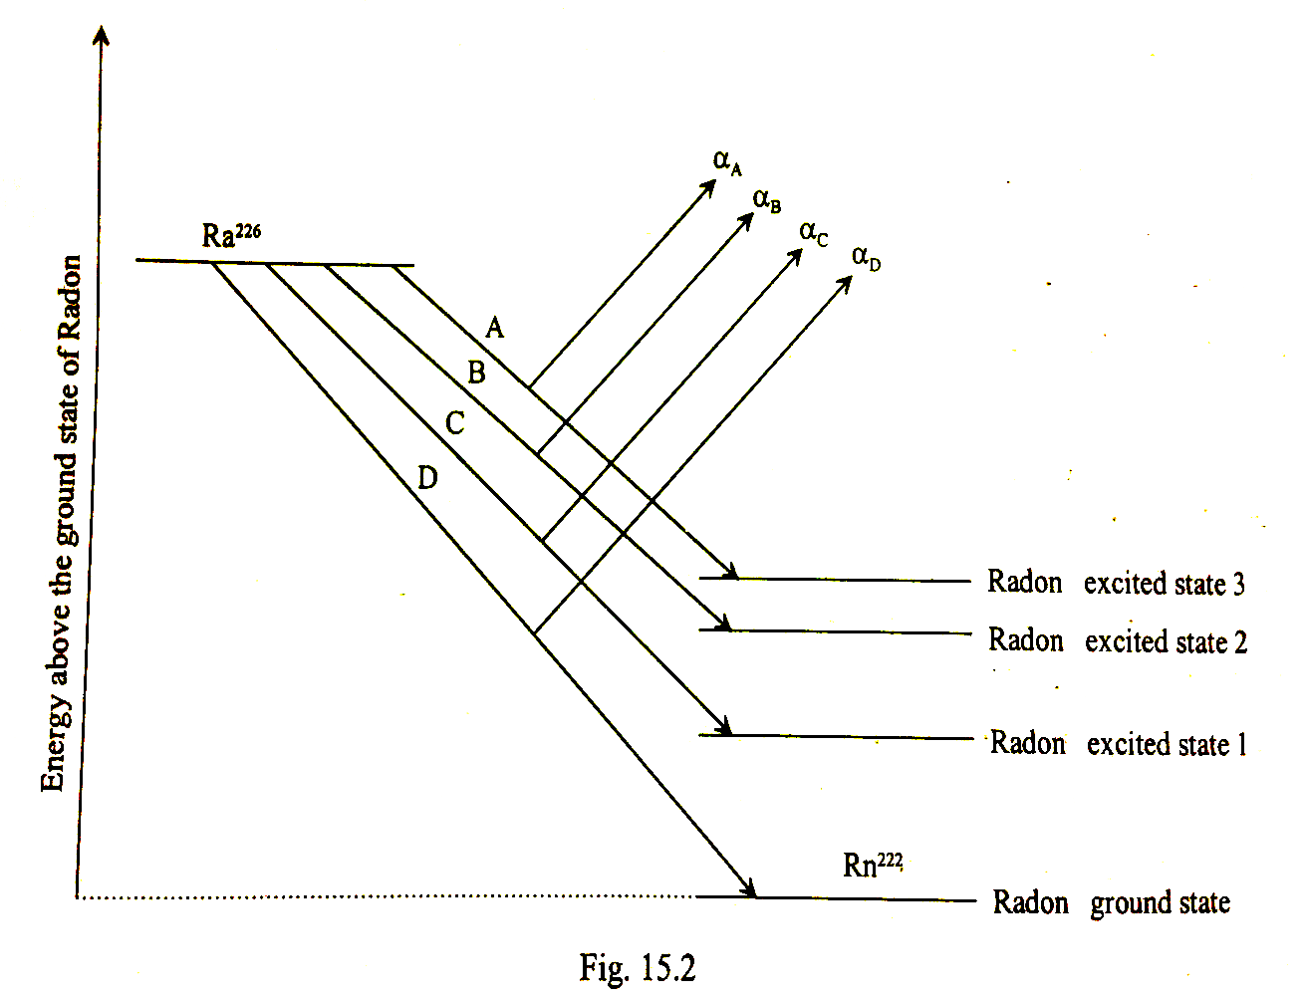
Alpha particle energy
Consider the alpha decay of radium to radon:

Slide 10

Beta decay
There are two types of beta decay :
neutrons to protons
  ${}_{0}^{1}n→{}_{1}^{1}p+{}_{−1}^{0}e+\overline{{}_{0}^{0}ν}.$
  General equation:
protons to neutrons
  ${}_{1}^{1}p→{}_{0}^{1}n+{}_{+1}^{0}e+{}_{0}^{0}ν.$
  General equation:

Slide 11
Neutrino and antineutrino
Early studies of beta decay did not detect the neutrino or antineutrino.
Experimental data showed that the electron in beta minus decay is ejected with:
  a range of kinetic energy values up to the predicted maximum
  at different angles to the daughter nucleus.
This would violate both conservation of momentum and energy, unless a third particle was also ejected.

Slide 12
Neutrino and antineutrino
Have no charge
Have a very small rest mass
Travel at the speed of light
Can be assigned an energy and a momentum

Slide 13
What is a neutrino

Slide 14
Why neutrinos matter

Slide 15
Antimatter
The antineutrino and positron are examples of antimatter:
Particles that share the same mass as their matter counterparts, but qualities such as electric charge are opposite.
When a particle and its antiparticle counterpart come together, they annihilate and leave behind energy in the form of gamma photons.
Momentum and energy is conserved in the annihilation process.

Slide 16
Antimatter explained

Slide 17
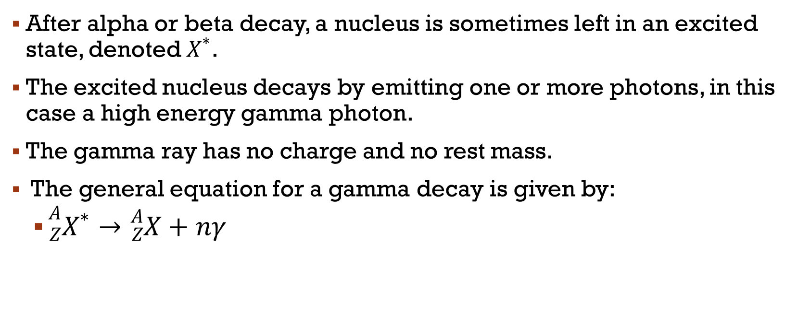
Gamma decay
After alpha or beta decay, a nucleus is sometimes left in an excited state, denoted${ X}^{∗}$.
The excited nucleus decays by emitting one or more photons, in this case a high energy gamma photon.
The gamma ray has no charge and no rest mass.
The general equation for a gamma decay is given by:
  ${}_{Z}^{A}{X^{∗}}→{}_{Z}^{A}X+nγ$

Slide 18
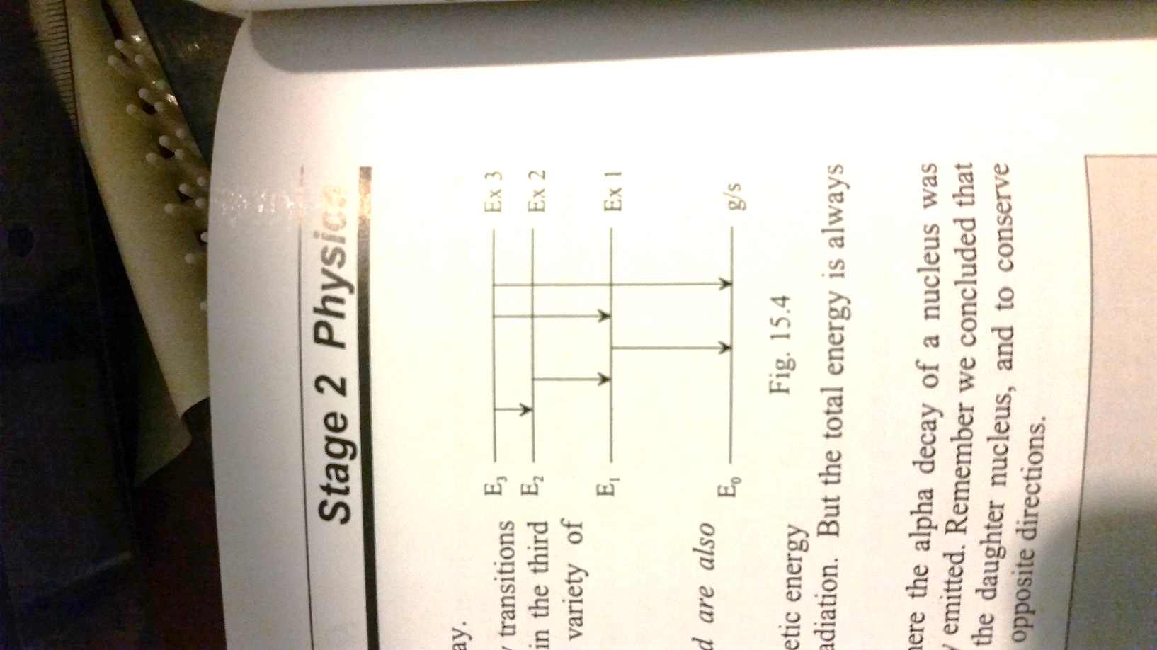
Gamma decay: discrete energies
The number of gamma photons emitted depends on the transitions of the nucleus down to the ground state.
The energy of the gamma rays correspond to the discrete energy levels of the excited states.

Slide 19
Spontaneous fission
Only occurs for very heavy nuclei
Nucleus splits into two nearly equal fragments and several free neutrons.
A large amount of energy is also released.
Most elements do not decay in this manner unless their mass number is greater than 230.
For example, uranium-238 spontaneously decays by fission.
But alpha decay occurs much more frequently.

Slide 20
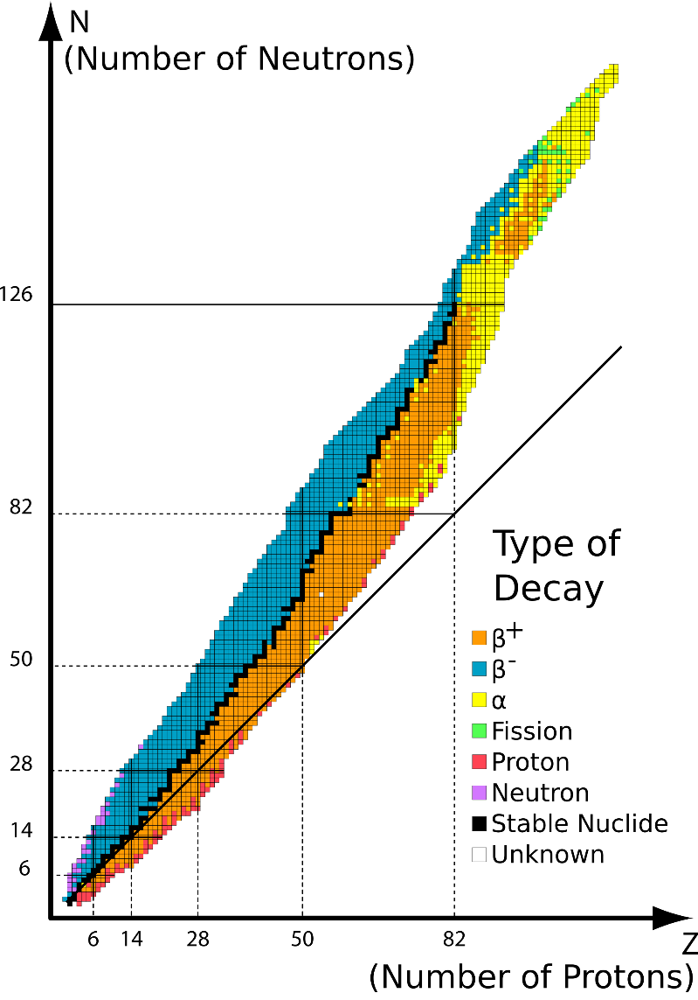
Decay trends in the N versus Z graph
In the N versus Z graph, we can see a general pattern in the types of decay a nucleus undergoes:
Alpha decay occurs for nuclei with Z > 83
Beta minus decay occurs for nuclei above the graph of stable nuclei.
Beta plus decay occurs for nuclei below the graph of stable nuclei.
Spontaneous fission occurs for some nuclei with Z > 83 .

Slide 21
Some properties of radioactive emissions
Alpha, beta and gamma radiation ionise the material through which they pass.
Can be subatomic particles moving at very high speeds or electromagnetic waves with high frequency.
Ionising radiation has enough energy to free electrons from atoms or molecules, thus ionising them.
Charged particles can ionise atoms directly through the Coulomb force
Photons can ionise atoms through the photoelectric effect and Compton scattering.
The charged particles can go on to produce further ionisation.

Slide 22
Alpha radiation
Alpha particles have a large mass and +2 charge.
They are also ejected with high kinetic energies.
Alpha particles are able to collide with atoms and knock out electrons by collisions as well as the Coulomb force.
Due to the collisions, alpha particles lose kinetic energy quickly and do not penetrate far.

Slide 23
Beta radiation
Beta particles are much smaller than alpha particle and have half the charge.
Less likely to ionise atoms by collision or by the Coulomb interaction.
Beta particles can penetrate much further into matter than alpha particles.

Slide 24
Gamma radiation
Gamma rays have no mass or charge
Hence their interaction with matter is less than alpha and beta radiation.
The ionising power is very low and gamma photons can penetrate very deeply into matter before their energy is absorbed.

Slide 25
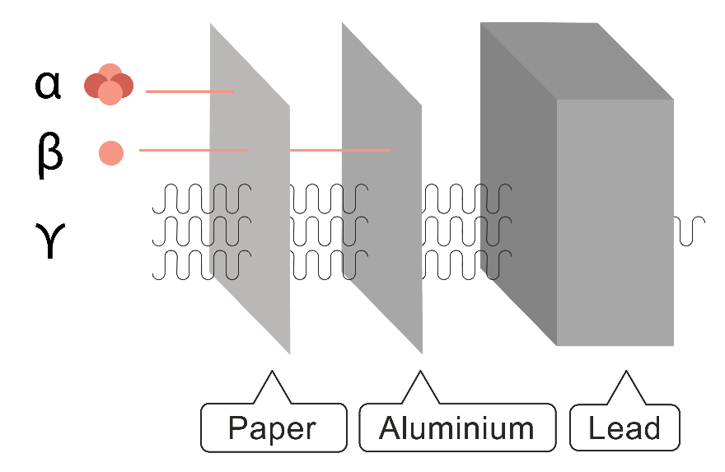
Penetration power
The more ionising the radiation, the lesser the penetration power because kinetic energy is lost in the interaction with matter.
Gamma radiation is more penetrating than beta radiation and beta radiation is more penetrating than alpha radiation.

Slide 26
Effects of electric and magnetic fields
Alpha particles and beta particles, as moving charges, will experience a force in both an electric and magnetic field.
Gamma radiation will pass through an electric field and a magnetic field undeflected because it has no charge.

Slide 27
In an electric field
The force is determined from F=Eq
Positive charges move in the direction of the electric field, negative charges move opposite to the electric field.
If the initial velocity of the radiation is parallel to the electric field, then the motion is analogous to freefall
If the initial velocity is perpendicular to the electric field, then the motion is analogous to projectile motion with the alpha or beta particle tracing out a parabolic path.
An alpha particle will experience a smaller acceleration than a beta particle, due to its greater mass. Hence the deflection in the electric field will also be less.

Slide 28
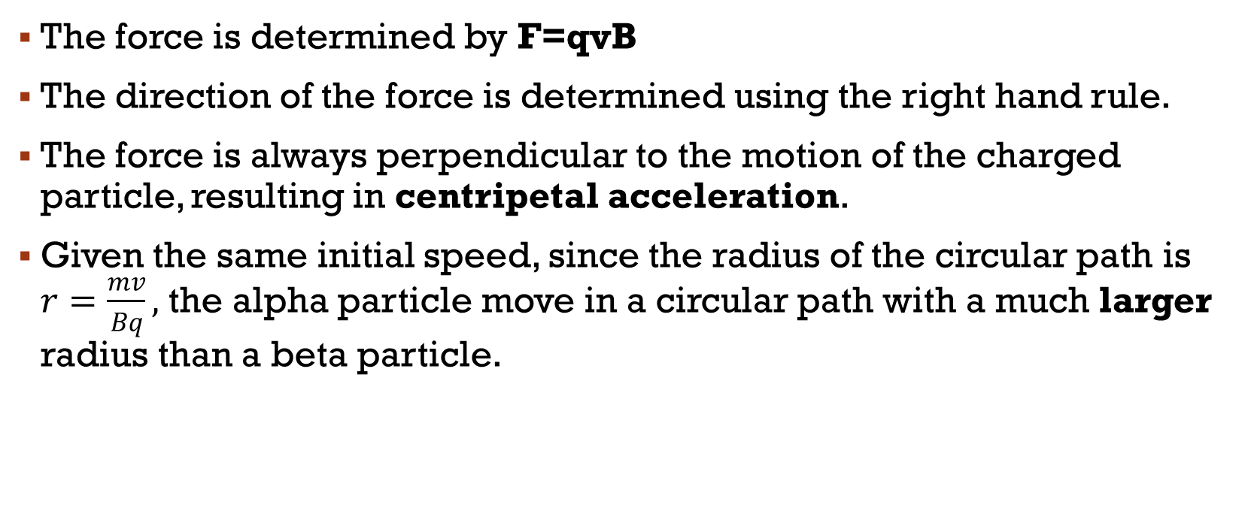
In a magnetic field
The force is determined by F=qvB
The direction of the force is determined using the right hand rule.
The force is always perpendicular to the motion of the charged particle, resulting in centripetal acceleration.
Given the same initial speed, since the radius of the circular path is $r=\frac{mv}{Bq},$ the alpha particle move in a circular path with a much larger radius than a beta particle.

Slide 29

The most radioactive places on earth

Slide 30
The effect of ionising radiation on living matter
Other examples of ionising radiation are: UV, x-rays, protons, neutrons.
Ionising radiation can break chemical bonds in living matter. Possible effects are:
Breaking down molecules vital to cell function
Forming acidic substances which chemically attack cells
Altering genetic material in such a way that cells die
Mutations in DNA which can cause cancer or genetic defects to be passed on to offspring

Slide 31
Sources of ionising radiation
Cosmic radiation, either from the sun or outside the solar system. The radiation can be in the form of UV, high energy protons and other high energy particles.
Background radiation due to the natural decay of radioactive isotopes in rocks and structures of earth.
Common examples are bananas containing potassium-40 and radon gas radioisotopes found in cellars and the foundations of a house.
Medical radioisotopes for example from x-rays or injection of medical radio isotopes.

Slide 32
Minimising radiation dosages
Increasing distance from the source
  Using tongs to handle radioisotopes
  Chernobyl exclusion zones
Limiting time of exposure
  Electronic Personal Dosimeter to monitor radiation for people working near sources of ionising radiation
  Short bursts of high radiation are especially damaging
Using adequate shielding
  Gloves stop alpha and beta radiation
  Concrete around nuclear power stations
  Lead aprons when taking x-rays

Slide 33
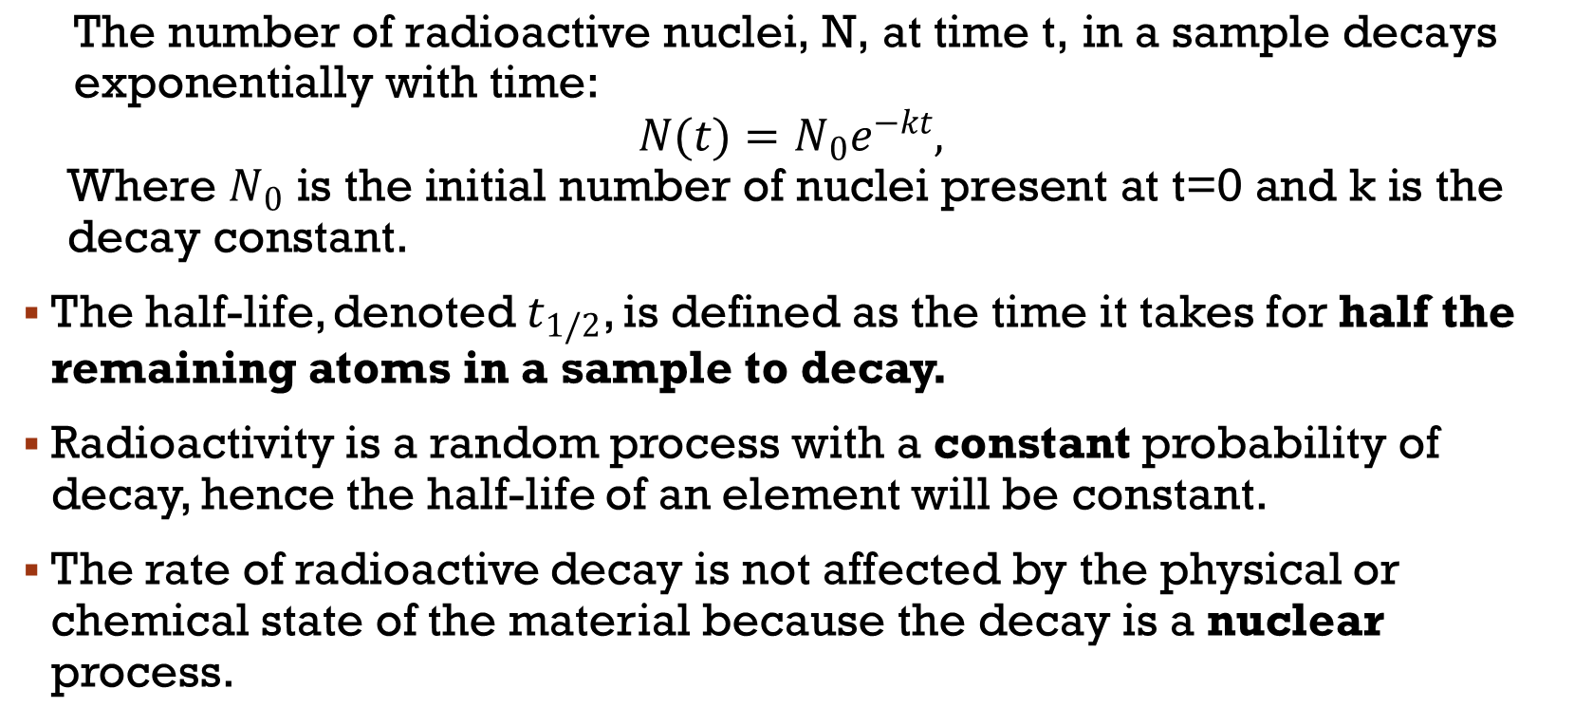
Half-life
$$\text{The} \text{number} \text{of} \text{radioactive} \text{nuclei}\text{, }\text{N}\text{, }\text{at} \text{time} \text{t}\text{, }\text{in} \text{a} \text{sample} \text{decays} \text{exponentially} \text{with} \text{time}\text{:}$$
$$N(t)=N_{0}e^{−kt},$$
$$\text{Where} N_{0} \text{is} \text{the} \text{initial} \text{number} \text{of} \text{nuclei} \text{present} \text{at} \text{t}\text{=0 }\text{and} \text{k} \text{is} \text{the} \text{decay} \text{constant}\text{.}$$
The half-life, denoted${ t}_{1/2}$, is defined as the time it takes for half the remaining atoms in a sample to decay.
Radioactivity is a random process with a constant probability of decay, hence the half-life of an element will be constant.
The rate of radioactive decay is not affected by the physical or chemical state of the material because the decay is a nuclear process.

Slide 34

Half-life derivation
We can solve for N as a function of time by solving the differential equation:
$$\frac{dN}{dt}=kN$$
You might like to try this yourself!

Slide 35
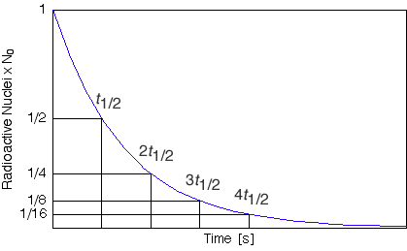

Slide 36
Activity
Often more convenient to consider the activity of a radioactive substance instead of the number or radioactive nuclei.
The activity of the decay is defined as the number of nuclear decays per second, which is the rate of decay.
The unit of activity is the Becquerel (Bq).
One Becquerel is equal to one decay per second.
The activity also decreases exponentially with time and has the same decay constant and hence, half-life as N.

Slide 37
PET SCANNER - IFAE Voxel Imaging PET Pathfinder

Slide 38
Positron emission Tomography (PET)
PET uses radioisotope tracers to detect abnormal functions in bodily organs.
Where the molecule ends up in the body can be very informative.
For example, labelling glucose with fluorine-18 to make FDG (fluorodeoxyglucose) will indicate areas of high metabolic activity such as in cancerous cells.
Oxygen-15 is another radioactive isotope which can be incorporated into water and used to monitor the flow of blood in tissues.

Slide 39
PET
Both fluorine-18 and oxygen-15 decay by beta plus decay, which is the basis of PET analysis:

Slide 40
PET
The PET analysis uses a scanner to detect the emitted gamma rays.
A computer analyses the results to match photons emitted at roughly the same time but opposite directions.
The annihilation event will be located somewhere on the line connecting the two photon detection points.
Newer systems use the slight difference in the time of flight of the photons to identify the most likely location of the annihilation event.

Slide 41
PET

Slide 42
PET
Positron emitting isotopes used in medical imaging tend to be short-lived, in order keep patient radiation doses low and so that there are more photons to image.
For example, fluorine-18 has a half-life of 110 minutes, while oxygen-15 has a half-life of 2 minutes.
This means the PET facility needs to be close to a particle accelerator so that the radioisotope can be inserted rapidly.

