Slide 1
Nuclear fission and fusion

Slide 2
Phet - http://tinyurl.com/q48jpcu
PET - https://www.youtube.com/watch?v=5Zu3ZdEvz8M
Nuclear energy - https://www.youtube.com/watch?v=rcOFV4y5z8c
Cons - https://www.youtube.com/watch?v=HEYbgyL5n1g
Pros - https://www.youtube.com/watch?v=pVbLlnmxIbY
PWR - https://www.youtube.com/watch?v=Qthg5xE196w
Delayed emission - http://hyperphysics.phy-astr.gsu.edu/hbase/nucene/control.html#c2

Slide 3
Nuclear Energy Explained: How does it work?

Slide 4
Spontaneous and induced nuclear fission
Spontaneous fission - the process by which very heavy nuclei split into two smaller nuclei, releasing energy in the MeV range.
Some atoms, such as uranium-235, uranium-233 and plutonium-239, can also be forced to undergo nuclear fission by the absorption of slow neutrons.
Since the neutrons have no charge, they can enter a nucleus without any coulombic repulsion.

Slide 5
Spontaneous and induced nuclear fission
Generally, a number of neutrons as well as gamma photons are emitted.
For example, consider the fission reactions of uranium:
$${}_{0}^{1}n+{}_{92}^{235}U→{}_{56}^{141}{Ba}+{}_{36}^{92}{Kr}+3{}_{0}^{1}n+γ \\ {}_{0}^{1}n+{}_{92}^{235}U→{}_{54}^{140}{Xe}+{}_{38}^{94}{Sr}+2{}_{0}^{1}n+γ \\ {}_{0}^{1}n+{}_{92}^{235}U→{}_{50}^{132}{Sn}+{}_{42}^{101}{Mo}+3{}_{0}^{1}n+γ$$
Due to being relatively neutron-rich for their atomic number, the products often undergo beta decay.

Slide 6
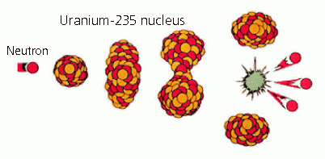
How does fission occur
When the neutron enters the nucleus, it can have the effect of distorting the shape of the nucleus.
It can also increase the vibrational energy of the nucleus causing it to vibrate in an elongated way.
When this occurs, it may not be possible for the short-ranged nuclear force to overcome the longer ranged columbic repulsion due to the increased distance.

Slide 7
Chain reaction
The release of neutrons in spontaneous fission can be used to cause other fissions in a chain reaction.
In a chain reaction, the products of the reaction initiate further reactions.
Fission chains result in a continuous production of heat, which is important in energy production in power plants.
In order to have a sustained chain reaction, at least one neutron per fission must induce another fission.

Slide 8
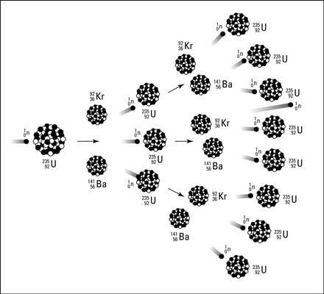
Chain reaction
Figure: Chain reaction schematic

Slide 9
Fast neutrons
The neutrons ejected in fission typically have energies of the order 1-2 MeV.
Fast neutrons result in less desirable reactions occurring, such as:
The ejection of a photon
The ejection of an alpha particle
Neither of these reactions produce much energy compared to the fission of a uranium-235.

Slide 10
Moderators
Moderators slow down neutrons by collisions.
Collisions with the neutrons dissipate the kinetic energy of the neutrons and transfers energy to the moderator.
Moderators need to be low mass nuclei, so that kinetic energy can be transferred from the neutron to the moderator.
For example: deuterium and carbon

Slide 11
Enrichment
The majority of the uranium fuel used in the reactor is uranium-238.
Slow neutrons minimise the absorption of the neutrons by the uranium-238 isotope:
$${}_{0}^{1}n+{}_{92}^{238}U→{}_{92}^{239}U+γ$$
Many of the neutrons will be absorbed by surrounding nuclei or escape, which does not help in maintaining a sustained chain reaction!

Slide 12
Enrichment
To overcome this:
The `core reaction’ is covered with a reflector blanket to reflect the slow neutrons back into the core.
The mass of the fuel needs to be able to maintain the chain reaction, also called the critical mass.
Naturally occurring uranium does not have enough uranium-235 to maintain a chain reaction.
The natural ore has to be enriched to increase the percentage of uranium-235, the increase is typically between 2 and 4%.

Slide 13
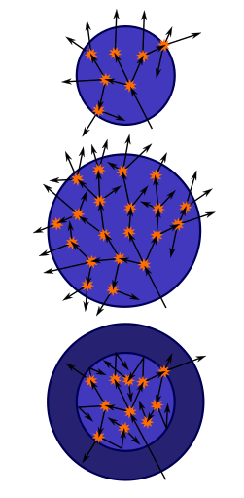
Critical MAss
Left: A sphere of fissile material is too small to allow the chain reaction to become self-sustaining as neutrons generated by fissions can too easily escape. Middle: By increasing the mass of the sphere to a critical mass, the reaction can become self-sustaining. Right: Surrounding the original sphere with a neutron reflector increases the efficiency of the reactions and also allows the reaction to become self-sustaining.

Slide 14
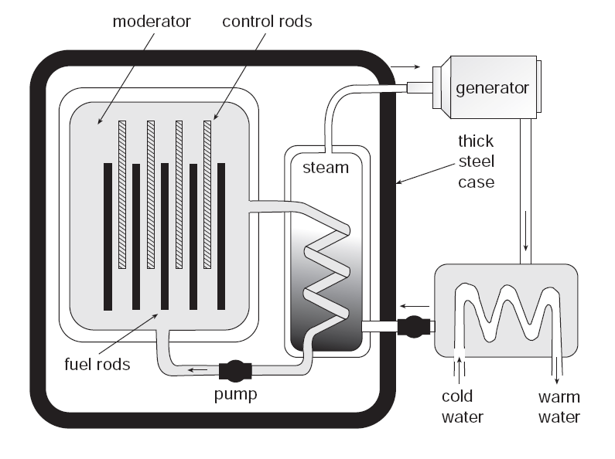
Application: Fission nuclear power
We will consider a water moderated power reactor.
The basic parts of a nuclear reactor are:
Core
A neutron moderator
Control rods
Safety rods
Radiation shielding
Thermal shield.
An outer biological shield
A coolant
Heat exchanger

Slide 15
PWR Nuclear Power Plant Animation

Slide 16
The control system – the control rods
Nuclear reactions can be controlled by the number of neutrons in the neutron flux.
To do this, elements that are effective absorbers of neutrons, such as boron and cadmium can be used.
If the reactor is required to produce more energy, the rods are pulled out to allow more neutrons to access the fuel and increase the number of fission reactions.
The reactor can be stopped by inserting the control rods and the safety rods fully into the core, absorbing all of the neutrons.

Slide 17
Delayed emission of neutrons
Neutrons emitted exist for a very short time.
Most fission reactions emit two or three neutrons, so the reaction could grow out of control very quickly.
About 1% of the neutrons in a reactor core come from delayed emission.
From decay of daughters of the fission reaction.
~10 second delay

Slide 18
Delayed emission of neutrons
One of the safety factors built into the nuclear reactors which are used for electricity generation is that they are only critical with the inclusion of the delayed neutrons which are emitted by some of the fission fragments.
The neutron population of the core is maintained such that the delayed neutrons are required to sustain the chain reaction.
This way the doubling time of the reaction is significantly increased.

Slide 19
How do reactors work?

Slide 20
3 Reasons Why Nuclear Energy Is Terrible!

Slide 21
3 Reasons Why Nuclear Energy Is Awesome!

Slide 22
Advantages and disadvantages
Advantages:
Zero carbon emissions
No toxic emissions of carbon monoxide, sulfur oxide and nitrogen oxides
Large amounts of energy for a small amount of fuel
Disadvantages:
Thermal pollution from heat exchanger warming up water
Disposal of spent fuel rods which are radioactive
Decommissioning of nuclear power stations
Potential for accidents
Threat of nuclear weapons

Slide 23
Nuclear Fusion
In contrast to nuclear fission, fusion involves the joining together of two small nuclei to form a large, more stable one.
The major source of energy in the universe comes from nuclear fusion reactions.
Generally, more energy is released in fusion than fission.
For example, the sun generates its energy from nuclear fusion.
In order for fusion to occur, high kinetic energies are needed to overcome the repulsive electrostatic force between the nuclei and to allow the nuclei to approach within the very short range of the nuclear-attractive forces.
Nuclei with the required kinetic energy need to be at a temperature of about 100 million °C.

Slide 24
Nuclear Fusion
A typical fusion reaction involving deuterium${}_{1}^{2}H$, and t$ritium {}_{1}^{3}H$, is:
$${}_{1}^{2}H+{}_{1}^{3}H→{}_{2}^{4}{He}+{}_{0}^{1}{n. (17.6 MeV)}$$
Other fusion reactions are:
$${}_{1}^{2}H+{}_{1}^{2}H→{}_{2}^{3}{He}+{}_{0}^{1}{n,} (3.2 MeV)$$
$${}_{1}^{2}H+{}_{1}^{2}H→{}_{1}^{3}H+{}_{1}^{1}{H.} (4.0 MeV)$$
First reaction releases much more energy!
This is because the products in the second and third reaction do not have the binding energy and hence stability of the helium nucleus.

Slide 25
Nuclear Fusion
In fact, when a helium nucleus is formed in a fusion reaction, a large amount of energy is always released. For example,
${}_{1}^{2}H+{}_{2}^{3}{He}→{}_{2}^{4}{He}+{}_{1}^{1}{H (18.3 MeV)}.$
${10}^{7}$ times more energy per mass than chemical reaction.
Deuterium, ${}_{1}^{2}H$, features in many of our fusion reactions because those reactions have the highest probabilities of fusion at the lowest energies.
Other reactions involving heavier elements are possible.

Slide 26
The sun
The internal temperature of the sun’s core is about 20 million °C, lower than required for fusion.
However, the protons in the Sun are racing around at a range of velocities according to the temperature.
While the typical velocity is far too small to defeat the Coulomb barrier, some electrons on the tail of the velocity distribution curve do have enough energy.
$${}_{1}^{1}H+{}_{1}^{1}H→{}_{1}^{2}H+{}_{+1}^{0}e+ν \\ {}_{1}^{1}H+{}_{1}^{2}H→{}_{2}^{3}H+γ \\ {}_{2}^{3}{He}+{}_{2}^{3}{He→{}_{2}^{4}He+{}_{1}^{1}H+{}_{1}^{1}H}.$$

Slide 27
The sun
Notes:
Two protons are produced, which can continue the cycle
The gravitational attraction of the sun holds the plasma together, ensuring that the density is high enough to allow for a high rate of particle collision.
The alpha particles have very large kinetic energies, which is quickly transferred back into smaller nuclei through collisions, since the alpha particles are charged and relatively large.

Slide 28
Advantages and disadvantages
Advantages:
The fuel, deuterium, is found in water in almost inexhaustible amounts, about $4.5× {10}^{16} kg$ is in the sea. At present consumption, this would last about 1 billion years.
The waste products are generally not radioactive.
No greenhouse gas emissions.
Safer to operate as only a few grams of fuel are present in the plasma vessel at a time and there is no chain reaction to control.
Disadvantages:
No net production of energy at this point in time.
Billions of dollars of research funding required to develop.

Slide 29
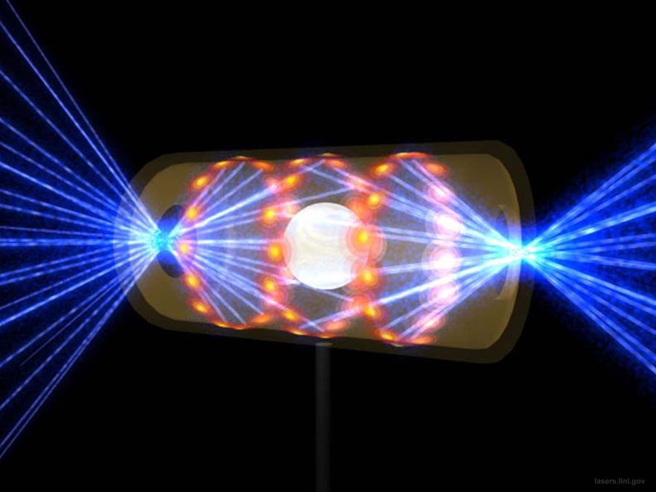
INERTIAL CONFINEMENT FUSION
Image credit: Lawrence Livermore National Laboratory.
We take a pellet of hydrogen — the fuel for this fusion reaction — and compress it using many lasers that surround the pellet. The compression causes the hydrogen nuclei to fuse into heavier elements like helium, and releases a burst of energy.

Slide 30
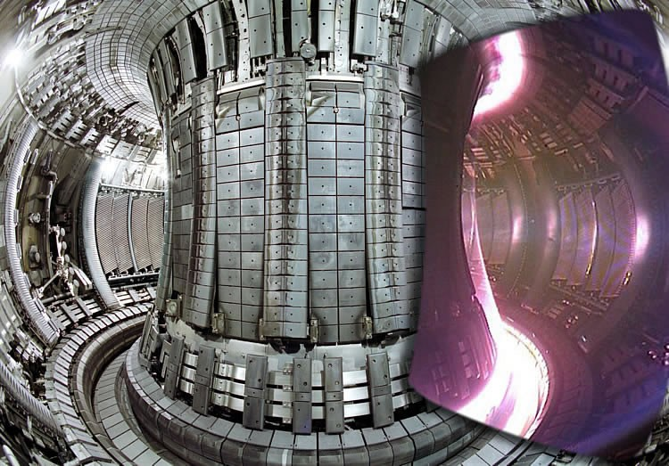
Magnetic Confinement Fusion
Image credit: the ITER (International Thermonuclear Experimental Reactor) Tokamak, courtesy of http://iter.org/.
Magnetic fields confine a superheated plasma of fusible material, and nuclear fusion reactions occur inside this Tokamak-style reactor.

