Slide 1
Atoms & Nuclei
The Structure of the Atom

Slide 2
The Structure of the Atom
Atoms are made up of a dense, positively charged nucleus and negatively charged electrons that orbit in specific energy levels around the nucleus.
The line emission spectrum of a specific element can be used to explain the unique way in which electrons are arranged around its nucleus.

Slide 3
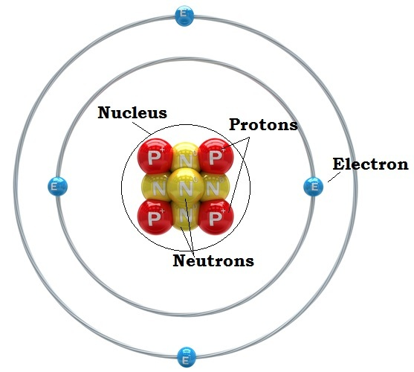
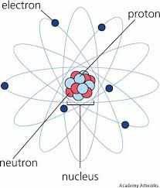
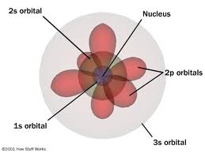

Slide 4
When an element in gaseous or vapour form is excited (heated), it will emit light of frequencies specific to that element
When this light is directed through a diffraction grating or spectrometer, it is split into its component colours.
These colours make up a line emission spectrum that is unique to each element and so can be used to identify specific elements.
The line emission spectrum will be made up of discrete lines, corresponding to individual frequencies on a black background.

Slide 5
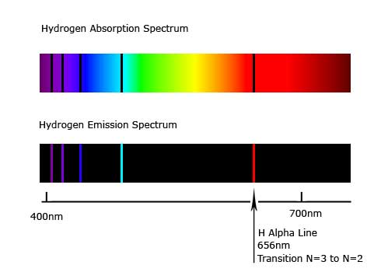

Slide 6
There may be lines present in the visible, infrared and ultraviolet regions of the electromagnetic spectrum.

Slide 7
The line emission spectra of elements allow us to understand how electrons are arranged within the atoms of those elements (electronic structure).
Our model for this electronic structure must be able to explain why distinct frequencies of light are present in the spectra of each element.

Slide 8
Energy Levels in Atoms
In atoms, electrons are found orbiting the nucleus in specific stable orbits.
These orbits correspond to discrete energy levels within the atom.
Electrons in higher orbits (ie further away from the nucleus) will have more energy than electrons in lower orbits.
Electrons will try to occupy the lowest energy that they can as this will be their most stable state.
Electrons can, however, move to higher energy levels if they are given more energy.

Slide 9
It has been observed that electrons will only move from lower energy levels to higher energy levels by absorbing the exact amount of energy corresponding to the energy difference between the two levels.
Thus, the energy required to force an electron from a lower energy level to a higher energy level is given by E = E_{higher} – E_{lower}.
However, if the energy supplied does not correspond directly to a particular energy gap, then the electron will not absorb any energy.

Slide 10
Electrons that are forced to higher energy levels in this way will rapidly fall back to lower, more stable positions.
When this happens, an amount of energy corresponding to the energy difference between the levels is released as a photon.
This photon will therefore have an energy given by E_{higher} – E_{lower} = E = h.f, where f is the frequency of the emitted photon.
The above theory explains the discrete frequencies of light that are present in line emission spectra.
Each frequency of the emitted light corresponds to a specific electron jump between different energy levels.

Slide 11
New Terms
Ground state of an electron – the lowest energy level that a specific electron can occupy in an atom.
Ground state of an atom – the lowest energy level that the most energetic electron can occupy in an atom.
Ionisation energy – the minimum amount of energy required to free an electron from the atom’s ground state. It equals the energy of the highest energy level minus the energy of the ground state.
Transition – the movement of electrons between the energy levels due to the absorption or emission of specific amounts of energy.
Excitation state – all energy levels above the ground state are considered excitation states.

Slide 12
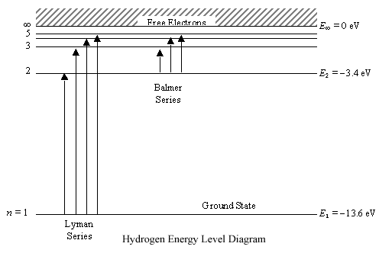

Slide 13
The Line Emission Spectrum of Atomic Hydrogen
The line emission spectrum of hydrogen’s single electron can be divided into several series of lines.
Each series has a maximum frequency in a different part of the electromagnetic spectrum.
Remember that E = h.f and therefore the maximum frequency light wave of each series coincides to the greatest energy jump.
This frequency is known as the series limit.
Each series corresponds to a transition down to a specific energy level.
In hydrogen, the three series that correspond to transitions down to the lowest three energy levels are given special names:

Slide 14
Transitions down to the ground state are called the Lyman Series. The photons emitted in this series have ultraviolet frequencies, as their energies are higher than the other series.
Transitions down to the second energy level are called the Balmer Series. The photons emitted in this series have visible frequencies.
Transitions down to the third energy level are called the Paschen Series. The photons emitted in this series have infrared frequencies, as their energies are lower than the other series.

Slide 15
Continuous Spectra
The particles within any object are continuously vibrating, and emitting electromagnetic radiation.
When objects are heated, the energy of each particle increases and so the energy of the radiation emitted also increases.
At higher temperatures, the particles will emit infrared radiation, while at even higher temperatures the particles may emit visible light.
The particles will all vibrate at different frequencies so the radiation emitted by these vibrating particles will cover a continuous range of frequencies.
For this reason, it is known as a continuous spectrum.

Slide 16
Continuous Spectra
Heating solids, liquids or dense gases can therefore produce continuous spectra in the visible region, with the dominant frequencies emitted by an object being related to its temperature.
As the temperature of the object increases, the following changes are observed:
At normal temperatures – low frequencies of electromagnetic radiation are emitted
At high temperatures – infrared radiation is emitted
At higher temperatures – visible light is emitted, ranging from red to yellow to blue as temperature increases.
At still higher temperatures – ‘white’ light is observed at extreme temperatures, where there is an even spread of frequencies across the visible ranges.

Slide 17
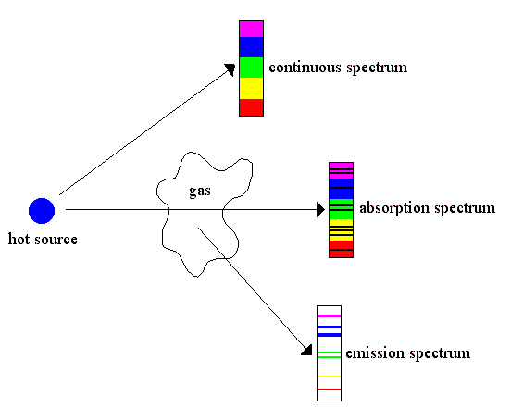

Slide 18
Line Absorption Spectra
When a continuous spectrum of white light is passed through the heated gas of an element, the atoms absorb particular frequencies of light.
Each frequency corresponds to a particular energy transition in the atoms.
The electron absorbs a photon with energy that corresponds to a possible jump the electron can make.
When the excited electrons move back to their ground state they emit the radiation they previously absorbed in random directions.

Slide 19
Line Absorption Spectra
If a spectrometer is placed in the path of the incident white light, it will detect a line absorption spectrum.
This consists of a continuous spectrum with dark lines corresponding to the specific frequencies that have been absorbed by the element.
The absorption lines present in the line absorption spectrum of an element will be a subset of the lines in its emission spectrum
Explain why there may be more lines on an emission spectrum than an absorption spectrum

Slide 20
Line Absorption Spectrum of Hydrogen
The line absorption spectrum of hydrogen is a continuous spectrum with absorption lines at frequencies corresponding to the ultraviolet line emission series (Lyman Series).
At room temperature, there are no absorption lines present in the visible absorption spectrum of hydrogen.
This is because at room temperature hydrogen atoms are in their ground state.
The amount of energy required to excite the atom to its first excited state is 10.2 eV, and must be provided by a single photon.

Slide 21
Line Absorption Spectrum of Hydrogen
Calculate the energy of the photon required for this transmission
Find the wavelength of this photon
In what area of the spectrum is this photon?

Slide 22
Fraunhofer Lines
The Sun’s emission spectrum actually contains a number of dark lines (absorption lines) called Fraunhofer Lines.
Light produced by the Sun covers a continuous range of frequencies and hence should produce a continuous spectrum.
However, atoms in the Sun’s and Earth’s atmospheres will absorb certain frequencies of the light emitted.
These frequencies correspond to the dark lines in the absorption spectra of those elements.

Slide 24
Fluorescence
Fluorescence is the process by which atoms absorb ultraviolet light photons and reemit the energy as a larger number of lower energy photons (in the visible region).
When atoms absorb a high energy photon (ie ultraviolet), the electrons will be forced to move up a number of energy levels.
The electrons will quickly return to their ground state, often in a series of steps through intermediate energy levels.
Each step will cause the electron to emit a photon with less energy than the one initially absorbed.

Slide 25
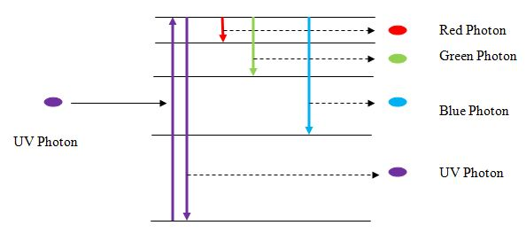
Some of these photons will be in the visible region and so the atoms will emit visible light.
As a result, fluorescent substances will appear to glow when UV light is shone on them.

Slide 26
Spontaneous Emission
Atoms can absorb energy from photons or collisions and move to an excited state.
The atom can then move back into its ground state by spontaneously emitting a photon in a random direction and with a random phase.
The photon will have an amount of energy (ΔE) corresponding to the difference in energy levels.
This is known as spontaneous emission, implying that there was no external cause for the transition.

Slide 27
Stimulated Emission
When an atom is already in an excited state, it can be stimulated to return to its ground state before spontaneous emission occurs. This is called stimulated emission.
Stimulated emission will occur when a photon with energy equal to ΔE collides with the excited atom.
This will cause the excited atom to return to its ground state and in the process emit another photon with energy equal to ΔE.
The two photons (the incident and emitted photons) will travel off in the same direction and be in phase.

Slide 28
Stimulated Emission
In some elements, the atoms can exist in an excited state for an extended period of time.
These excited states are known as metastable states.
If an atom has a metastable state, it is more likely to exist in its excited state.
It is possible for a sample of such atoms therefore to have more atoms in their excited state than ground state.
When this occurs it is called population inversion.

Slide 29
Stimulated Emission
Certain conditions are required for stimulated emission to predominate over absorption when light is incident on a set of atoms
There must be more atoms in the excited state than in the ground state (population inversion)
The excited atoms must be in the excited state long enough to be stimulate by a photon (a metastable state)

Slide 30
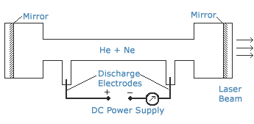
Application: Lasers
A laser is a device that produces a high intensity, monochromatic, coherent light beam using the principle of stimulated emission.
The name “laser” is an acronym for Light Amplified by Stimulated Emission of Radiation.

Slide 31
The Pump
In a helium-neon laser, the atoms of helium and neon must be excited for the stimulated emission to occur.
This excitation can be achieved by a component of the laser called the pump.
The method used by the pump varies from laser to laser, but in a helium-neon gas laser a high potential difference is applied across the tube.
This causes free electrons to travel at high speeds from one end of the tube to the other.
These electrons may collide with helium and neon atoms and hence elevate them to their excited state.

Slide 32
Medium
To produce stimulated emission, a laser must contain a substance (called the laser medium) made up of atoms that have metastable states.
In these metastable states, the electrodes are able to stay in an excited state for a longer time interval than usual.
In a helium-neon gas laser, a mixture of helium gas (15%) and neon gas (85%) is used.
Note that it is actually the neon gas that is the laser medium.
The helium is added to increase the efficiency of the system.

Slide 33
In a helium-neon gas laser, the pump excites the atoms of the laser medium, which is contained in a tube.
In this process, both helium and neon atoms are excited.
Neon has two main excited states, where the higher of the two has the added property of being a metastable state.
Helium makes the entire process more efficient as its single excited state has a very similar energy to the metastable excited state of the neon atoms, and thus collisions between helium and neon atoms can produce excited neon atoms.

Slide 34
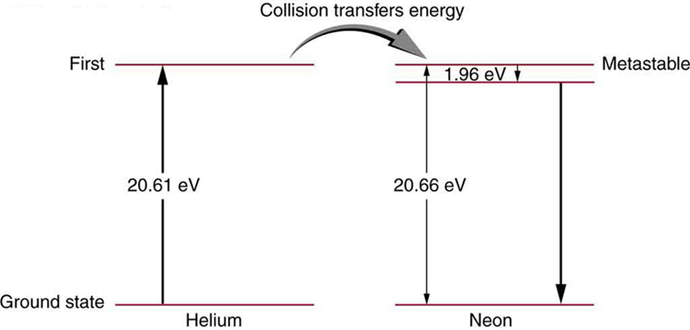
Note: since the transfer of energy occurs through a collision, the excited states do not need to be exactly the same.
Instead, the extra energy is obtained from the kinetic energy of the two atoms.

Slide 35
A majority of neon atoms will exist in their metastable state at any one time, and hence a population inversion will be produced.
When electrons that occupy the higher excited state of neon fall back to the lower excited state, a photon is released.
This photon has energy equal to the difference between the two energy levels.
This photon will subsequently collide with other neon atoms in the higher excited state, causing stimulated emission.

Slide 36
The Laser Cavity
The laser medium of helium and neon gas is contained in a tube.
The space in this tube is called the laser cavity.
Parallel mirrors are found at both ends of the laser cavity.
The function of these mirrors is to allow the light produced by stimulated emission to reflect back and forth many times, constructively interfering to produce a large amplification.
One of the mirrors allows some light to pass through it while reflecting the rest.
Therefore, the light produced exits the laser cavity through this mirror after amplification, producing the laser beam.

Slide 37
“Describe the useful properties of laser light”
Unidirectional – as a result of the stimulated emission and repeated reflection of the photons between the two parallel mirrors, the photons in the emitted light travel in the same direction.
Coherent – the phase of the photon emitted in stimulated emission is identical to that of the stimulating photon, and so the beam produced is coherent.
Monochromatic – the photons emitted in stimulated emission all have the same wavelength
Intense – As the light beam is unidirectional, it does not diverge greatly, and thus the intensity of the beam (determined by the number of photons) does not decrease significantly with distance.

Slide 38
“Discuss the requirements for safe handling of lasers”
Avoid exposing the skin to the laser beam
Avoid exposing eyes to the laser beam. This can be achieved by wearing safety glasses specifically designed for that laser’s frequency
Beware of reflecting surfaces
Also note electrical safety issues (as some laser use very high potential difference)

Slide 39
Identify some uses of lasers”
LADS
CD and DVD
Surveying
Barcode scanning
Surgery
Holography

